Slide 1
UFS(Universal Flash Storage)
By sravanthi
Chipweave technologies pvt lmd

Slide 2
Introduction
UFS stands for Universal Flash Storage
UFS is a high-speed internal storage standard used in smartphones, tablets, automotive systems, and embedded devices.
It defines how flash memory communicates with the processor.
Universal flash storage (UFS) is an open set standardized by Joint Electron Device Engineering Council (JEDEC). It is a high-performance storage interface designed to minimize the power consumption.
UFS is optimized protocol enable significant improvements in throughput and system performance

Slide 3
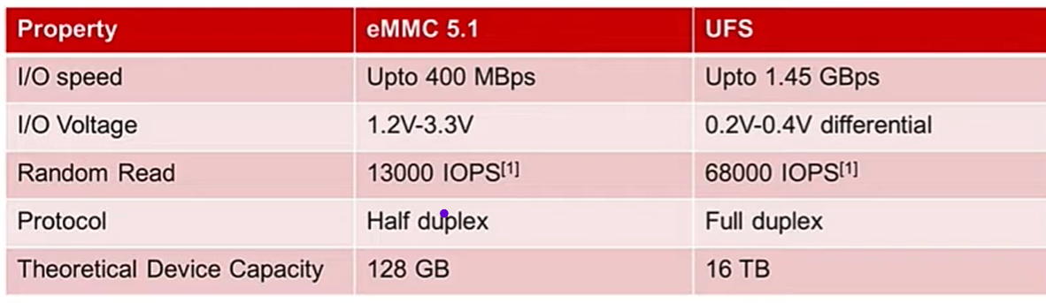
Why UFS
Before UFS, devices mainly used eMMC (embedded Multi Media Card)storage. As apps, cameras, and OS features grew, eMMC became a bottleneck.
Problems with eMMC
Half-duplex (read OR write, not both)
Low bandwidth
Higher latency
Poor multitasking performance
UFS was created to solve this, just like SSDs replaced HDDs in PCs.

Slide 4
UFS Versions
Version | Speed (approx)
UFS 2.1 | ~1.2 GB/s
UFS 3.0 | ~2.9 GB/s
UFS 3.1 | Same speed + better power
UFS 4.0 | ~5.8 GB/s

Slide 5
UFS (Universal Flash Storage) is a high-speed, full-duplex storage interface between:
Host → SoC / Application Processor
Device → UFS storage (NAND + controller)

Slide 6
How UFS Works
There are mainly 8 steps are there in UFS flow
Power-on & Reset : Host and UFS device power up and synchronize.
Link Startup (M-PHY + UniPro): Speed, lanes, and power mode are negotiated.
Device Initialization : Host reads device descriptors and capabilities.
Command Queue Setup :Host prepares multiple command slots.
Command Issue : Read/Write commands are placed into queues.
Full-Duplex Data Transfer: Read and write happen simultaneously.
Flash Management (inside device) :ECC, wear leveling, bad blocks handled internally.
Command Completion & Interrupt:Device sends completion, host frees the queue entry.

Slide 7
Power-on & Reset Step
What happens
Power is applied to Host (SoC) and UFS Device
Host asserts reset
Device enters a known idle state
Why this step exists
Ensures both sides start clean
Prevents garbage data transfer

Slide 8
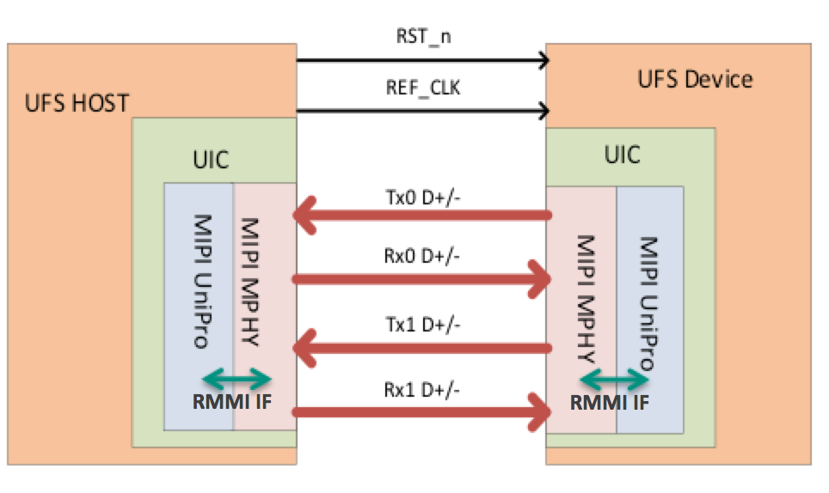
Link Startup (M-PHY + UniPro)
What happens
Host and device negotiate link parameters:
Number of lanes (1 or 2)
Speed gear (Gear1 → Gear4/5)
RMMI = Reference M-PHY Module Interface
MIPI → Mobile Industry Processor Interface
Outcome
Physical link becomes active
Switches from low speed → high speed
Without this step, UFS cannot communicate.

Slide 9
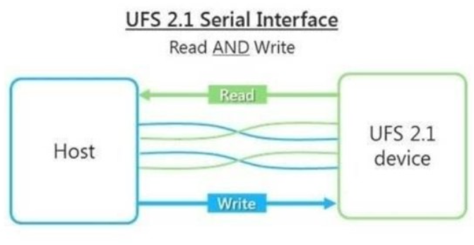
Device Initialization
What happens
Host reads device information:
Vendor ID
Capacity
Supported UFS version
Number of LUNs (Logical Units)
Why needed
Host must know what kind of device it is talking to
Similar to SSD IDENTIFY command
After this step, host understands device capabilities.

Slide 10
Command Queue Setup
What happens
Host creates multiple command slots
Each slot can hold one command
Commands follow SCSI model
Why this is powerful
Multiple commands can run in parallel
No need to wait for one command to finish
This is a huge advantage over eMMC.

Slide 11
Command Issue
What happens
Host places:
READ / WRITE command
Logical address
Transfer length
Command goes into the queue
CPU is free after issuing command
Storage works independently
Host (SoC)
├─ Command Slot 0 ──► READ
├─ Command Slot 1 ──► WRITE
├─ Command Slot 2 ──► READ
└─ Command Slot 3 ──► FLUSH
│
▼
UFS Device
(processes commands
in parallel)

Slide 12
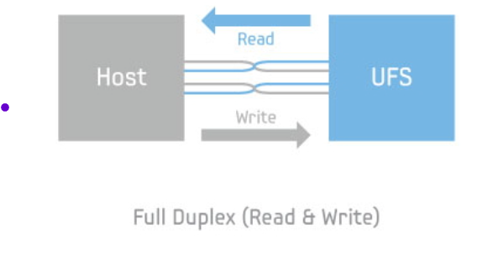
Full-Duplex Data Transfer
What happens
Read and Write happen at the same time
Separate TX and RX paths
Example
Reading app data
Writing camera video Simultaneously

Slide 13
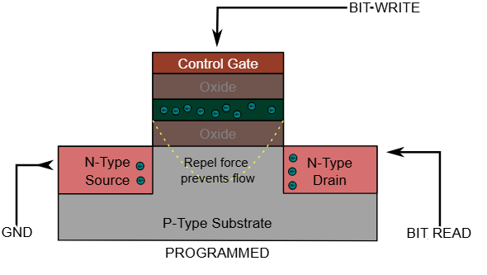
Flash Management (inside device)
What happens internally
UFS device controller handles:
Logical → Physical mapping
Wear leveling
Bad block management
ECC error correction
Important point
Host never sees raw NAND
Everything is abstracted
Makes system design simple and reliable.

Slide 14
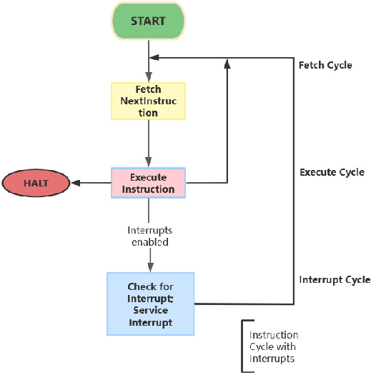
Command Completion & Interrupt
What happens
Device finishes command
Sends completion response
Host receives interrupt
Command slot is freed
Host can immediately issue new commands
After Step 8:
Steps 5 → 8 repeat continuously
Link may drop to low power when idle

Slide 15
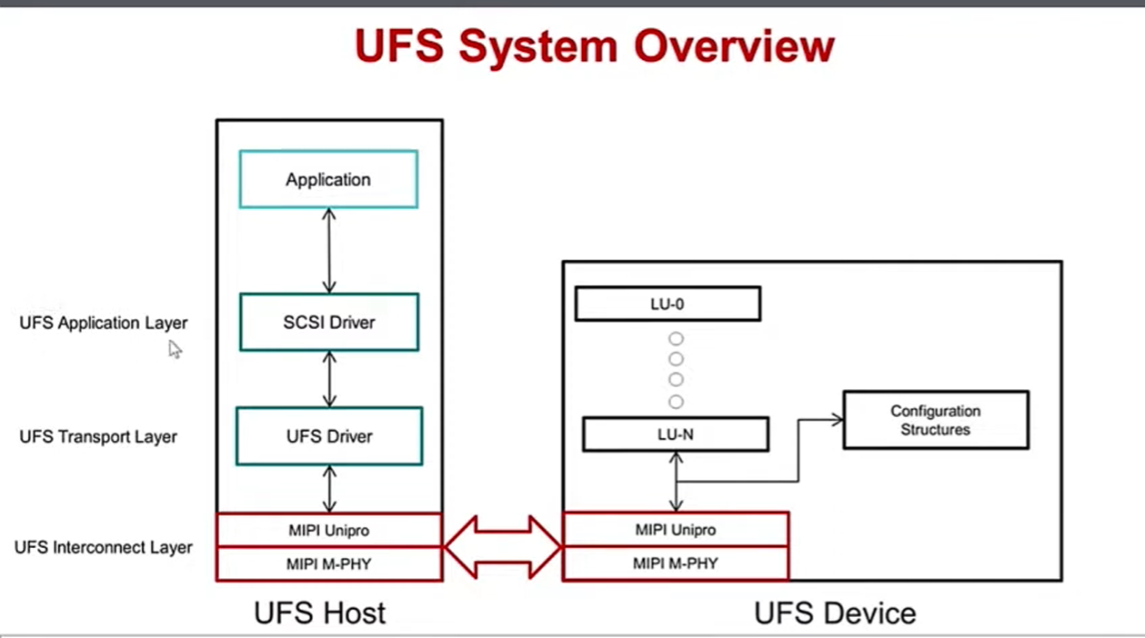
SCSI = Small Computer System Interface

Slide 16
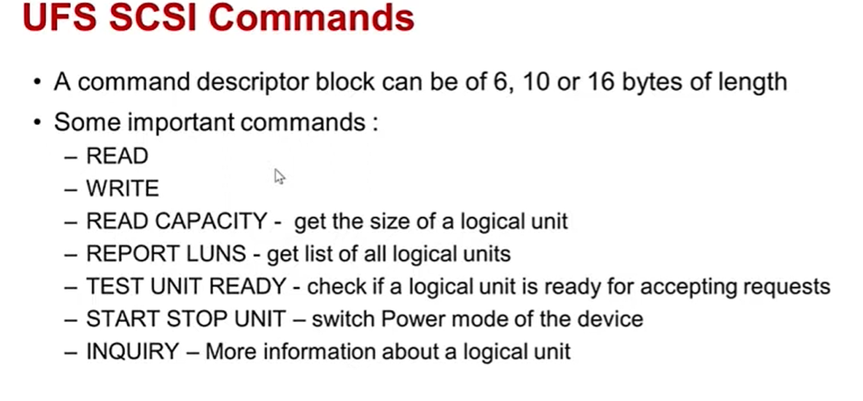

Slide 17
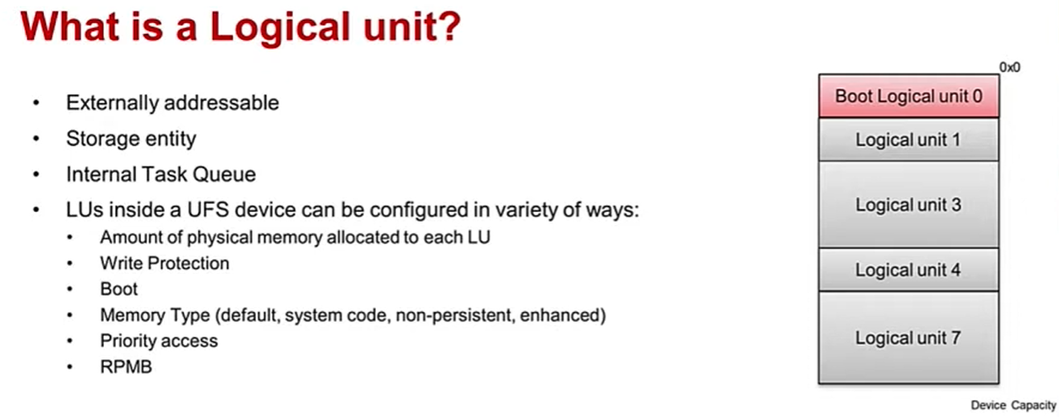

Slide 18
Advantages
High Performance
Much faster read/write speeds than eMMC
Supports high-speed gears (UFS 3.x / 4.0)
Full-Duplex Operation
Can read and write at the same time
Separate TX and RX paths
Smooth multitasking (video recording + app loading).
Command Queues (Low Latency)
Multiple commands in flight
SCSI-based queue model
CPU doesn’t wait for storage → better responsiveness

Slide 19
Better Power Efficiency
Dynamic power modes
Lanes and clocks shut down when idle
Faster + lower battery drain.
Scalable & Future-Ready
Higher gears and lanes can be added
Backward compatible across versions
Long-term ecosystem stability.
Enterprise-Like Reliability
Advanced ECC (Error Corretion Code)
Higher data integrity.

Slide 20
Disadvantages
Higher Cost
Design Complexity Requires:
M-PHY
UniPro
Complex link startup
Soldered on board
Cannot be replaced by user
Overkill for Low-End Devices
Simple IoT devices don’t need high speed
eMMC is cheaper and sufficient.
Thermal Constraints
High-speed operation can generate heat

Slide 21
Emphasis and De-emphasis
Emphasis and de-emphasis are transmitter equalization techniques that shape signals to overcome channel loss and keep high-speed data reliable.
Emphasis means intentionally boosting certain parts of a signal at the transmitter .
In high-speed links, the boosted part is usually the transitions (high-frequency content).
Why it’s needed
High frequencies get attenuated more than low frequencies
Emphasis sharpens the edges so the receiver sees clean data.

Slide 22
De-emphasis
De-emphasis means reducing the steady-state level of the signal relative to transitions at the transmitter.
It achieves the same goal as emphasis, but from the opposite angle.
Transitions stay strong
Long runs of 1s or 0s are weaker
Specs often quote de-emphasis in dB (e.g., −3.5 dB).

Slide 23
Conclusion
Emphasis → boost what matters
De-emphasis → reduce what causes problems
Both are forms of TX equalization.

Slide 24


